Slide 1
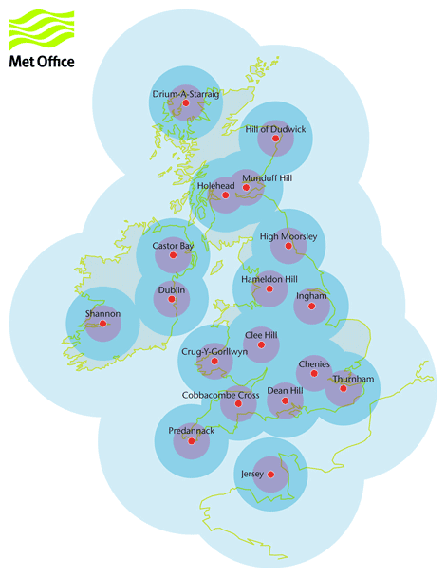


Please type the name of your poster here, increasing text box size as required
Author Name, Author Name, Author Name, Author Name, Author Name, Author Name
University of Leeds, University of Leeds, University of Leeds, University of Leeds, University of Leeds, University of Leeds
Section headings are in Calibri Bold font, light blue colour
Paragraph text is Calibri Light font, dark grey colour.
Font size will depend on how much text you have, but as a general rule try to keep it above 12pt for large posters.
Add graphics
Add graphics by selecting the ‘insert’ tab in the toolbar. Select ‘pictures’ and choose your graphic. Try to resize your graphics to match the width of each column. Bare in mind that you will need a high-quality image resolution if you are using a large paper size such as A1 or A0.
Section heading
Add and delete text boxes as required. The text boxes are currently all equal width, creating four equal columns.
Acknowledgements
Remember to add organisational logos to the bottom of the page, four partner logos have already been added as an example.
NCAS colours
You can select the NCAS green colour using the eyedropper tool, or you can choose to enter a custom colour. The RGB code for the NCAS dark green is 24,111, 77
Paragraph text is
Figure 2: The UK’s permanent weather radar network.

